Slide 1
16 bit Datapath
CSE332: Computer Organization and Architecture
Section 10

Slide 2
Group members: Zahin Ahmed (1711020042) Mustafizur Rahaman (1712847642) Ankit Dev (1721512642) Faculty: Dr Khaleda Ali (Kda1)

Slide 3
Aim of our project:
Creating a datapath for a 16 bit processor.
Our processor will be able to do the follow operations:
Load/Store
Arithmetic operations
Logical operations
Branching operations

Slide 4
Instruction formats:
R-format:
Opcode (4 bits)- RS(3 bits)- RT(3 bits)- RD(3 bits)- ShAmt(3 bits)
I-format:
Opcode (4 bits)- RS(3 bits)- RT(3 bits)- Immediate(6 bits)
RS= First source register
RT= Second source register
RD= Destination register
ShAmt= Shift Amount

Slide 5
Operations:
Instruction | Type | Opcode | Functionality | Assembly opcode | Format || Example
Load word | Data transfer | 0000 | Copy 16 bits from memory to register | lw | lw $rt im($rs) || lw $3 0($2)
Store word | Data transfer | 0001 | Copy 16 bits from register to memory | sw | sw $rs im($rt) || sw $5 6($1)
Load address | Data transfer | 0010 | Loads the decimal address(not its contents) into register | la | la $rt $zero im ||lui $3 $zero 10
Add | Arithmetic | 0011 | Adds the contents of 2 registers | add | add $rd $rs $rt || add $5 $4 $3
Subtract | Arithmetic | 0100 | Subtracts the content of one register from other | sub | sub $rd $rs $rt || sub $5 $4 $3
AND | Logical | 0101 | Bitwise AND | and | and $rd $rs $rt || and $5 $6 $7
OR | Logical | 0110 | Bitwise OR | or | or $rd $rs $rt || or $5 $6 $7
Underlined registers belong to that format i.e: are fixed.

Slide 6
Operations:
Instruction | Type | Opcode | Functionality | Assembly opcode | Format || Example
NOT | Logical | 0111 | Bitwise NOT | not | not $rd $rs $zero ||nor $1 $2 $zero
Shift left | Logical | 1000 | Shift left by constant number of bits | sl | sl $rd $rs $zero shm || sl $3 $4 $zero 2
Shift right | Logical | 1001 | Shift right by constant number of bits | sr | sr $rd $rs $zero shm || sr $3 $4 $zero 2
Or immediate | Data transfer | 1010 | Performs Or operation between a register and decimal | ori | ori $rt $rs im || ori $3 $3 14
Add immediate | Arithmetic | 1011 | Adds an immediate value to a register’s content | addi | addi $rt $rs im || addi $3 $zero 10
Branch on equal | Branching | 1100 | Test if registers are equal | beq | beq $rt $rs label || beq $3 $4 15
set if less than | Arithmetic | 1101 | Sets a register value to 1 if 1st reg < 2nd reg | slt | slt $rd $rs $rt
Underlined registers belong to that format i.e: are fixed.

Slide 7
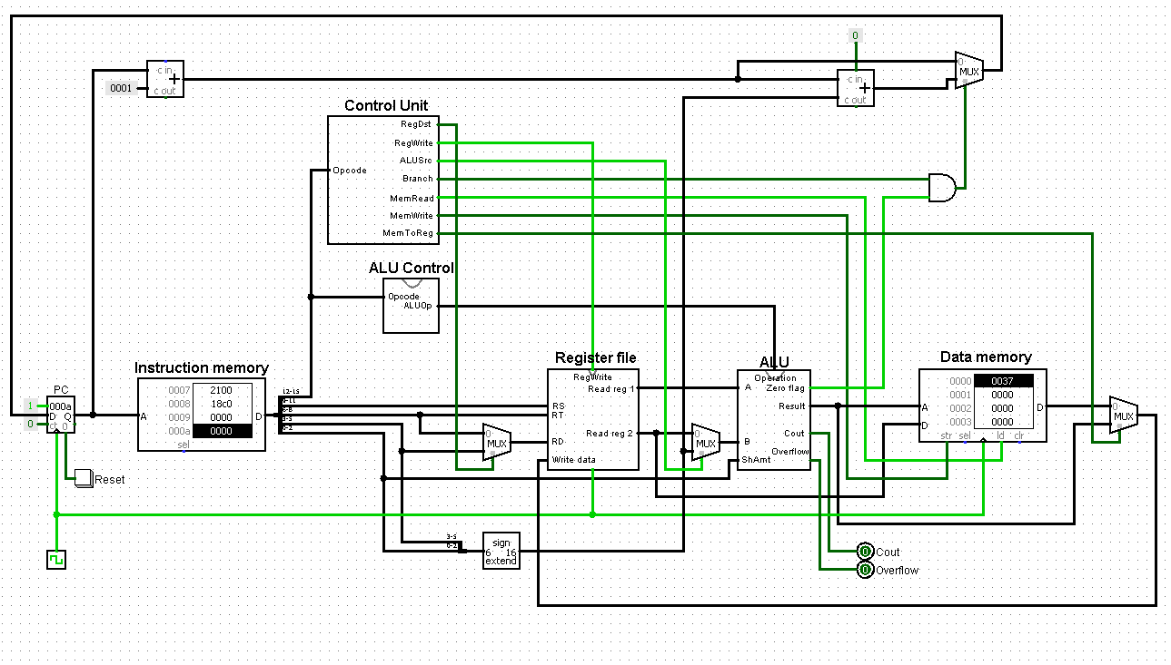
Full design of Datapath:

Slide 8
Control Unit
Generates all the control signals of the datapath (except ALU controls)
Designed using K-maps
Operation | Opcode | RegDst | RegWrite | ALUSRC | MemRead | MemWrite | MemtoReg | Branch
Load word | 0000 | 0 | 1 | 1 | 1 | 0 | 0 | 0
Store word | 0001 | X | 0 | 1 | 0 | 1 | X | 0
Load Add | 0010 | 0 | 1 | 1 | 0 | 0 | 1 | 0
Add | 0011 | 1 | 1 | 0 | 0 | 0 | 1 | 0
Sub | 0100 | 1 | 1 | 0 | 0 | 0 | 1 | 0
And | 0101 | 1 | 1 | 0 | 0 | 0 | 1 | 0
Or | 0110 | 1 | 1 | 0 | 0 | 0 | 1 | 0
Not | 0111 | 1 | 1 | X | 0 | 0 | 1 | 0
SLL | 1000 | 1 | 1 | X | 0 | 0 | 1 | 0
SRL | 1001 | 1 | 1 | X | 0 | 0 | 1 | 0
OrI | 1010 | 0 | 1 | X | 0 | 0 | 1 | 0
AddI | 1011 | 0 | 1 | 1 | 0 | 0 | 1 | 0
Beq | 1100 | X | 0 | 1 | 0 | 0 | X | 1
SLT | 1101 | 1 | 1 | 0 | 0 | 0 | 1 | 0

Slide 9
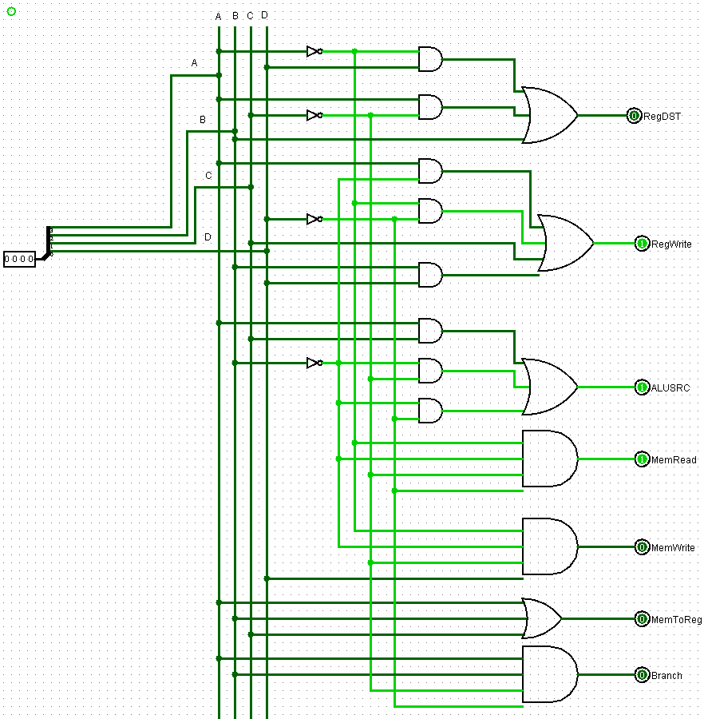
Control Unit:

Slide 10
ALU Control
Generates the control signals needed for the ALU i.e: controls that determine Addition/Subtraction/And/Shift etc
Implemented using a 16x1 multiplexer which takes the 4-bit opcode as select bits
Operation | Opcode | ALUOperation
Load word | 0000 | 0100
Store word | 0001 | 0100
Load Add | 0010 | 0100
Add | 0011 | 0100
Sub | 0100 | 0101
And | 0101 | 0000
Or | 0110 | 0010
Not | 0111 | 1100
SLL | 1000 | 1000
SRL | 1001 | 1010
Operation | Opcode | ALUOperation
OrI | 0010 | 0010
AddI | 0011 | 0100
Beq | 0101 | 0101
SLT | 0101 | 0111

Slide 11
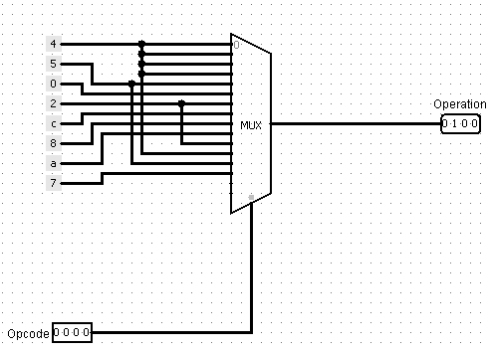
ALU Control:

Slide 12
16 Bit ALU
Performs the arithmetic operations (Addition, Subtraction, Set on less than, Branch on equal, Add immediate)
And the logical operations (And, Or, Not, Shift left logical, Shift right logical, Or Immediate)
Contains two separate circuits: One for dual operands (add, sub, addi, ori, and, or, slt, beq) and one for single operands (sll, srl, not)
Also generates the addresses used in load address, load word and store word
The dual operands circuit is designed by cascading 16 1-bit ALUs.
LSB and MSB have slightly separate circuits to facilitate the “Set on less than” operation

Slide 13
1 bit ALU (dual operand circuit)
Operation | 4x1 MUX select bits | B-inverter
AND | 00 | X
OR | 01 | X
ADD | 10 | 0
Set on less than | 11 | 1
Single operand circuit
Operation | 4x1 MUX select bits
Shift left logical | 00
Shift right logical | 01
Not | 10

Slide 14
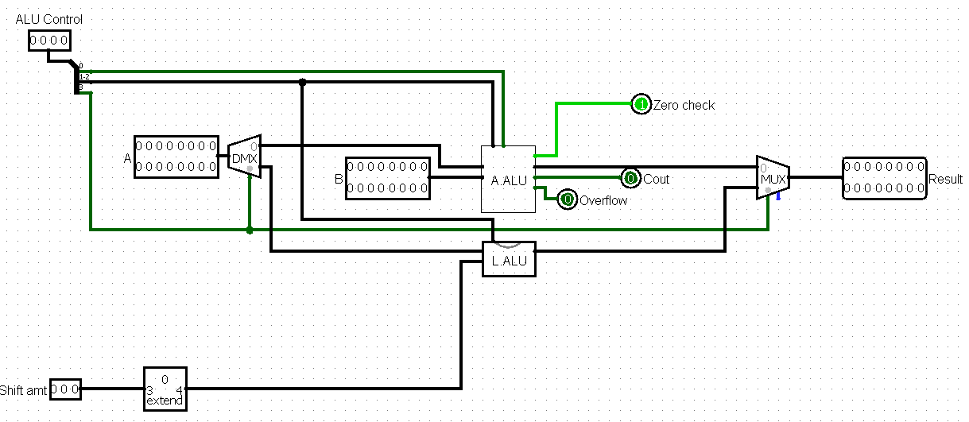
ALU:

Slide 15
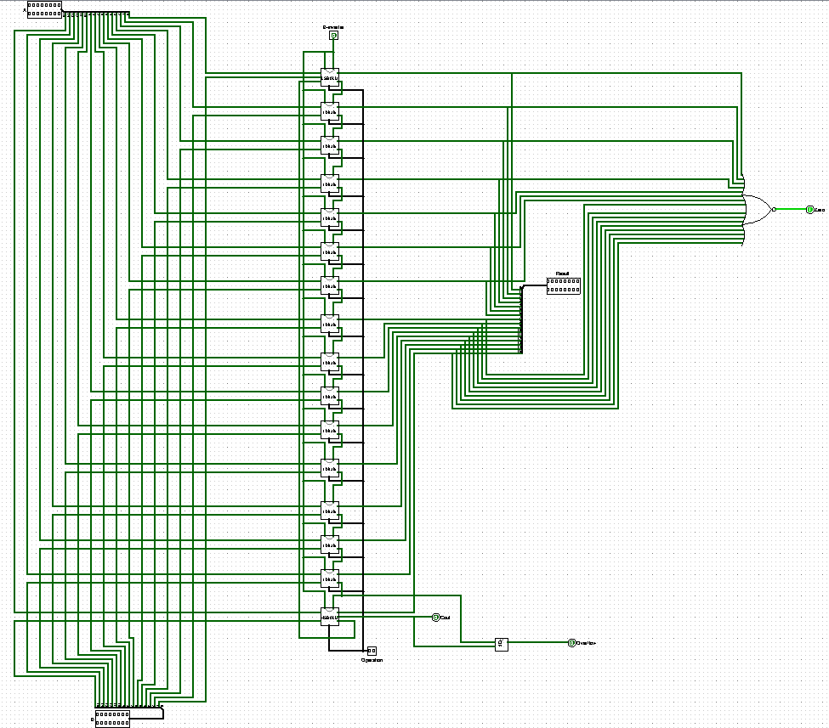
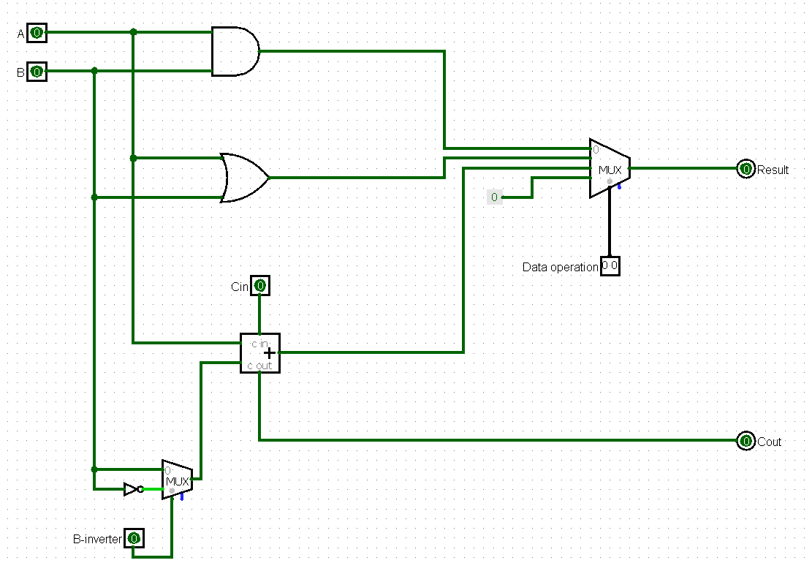
Dual Operand Circuit (16 bit and 1 bit)

Slide 16
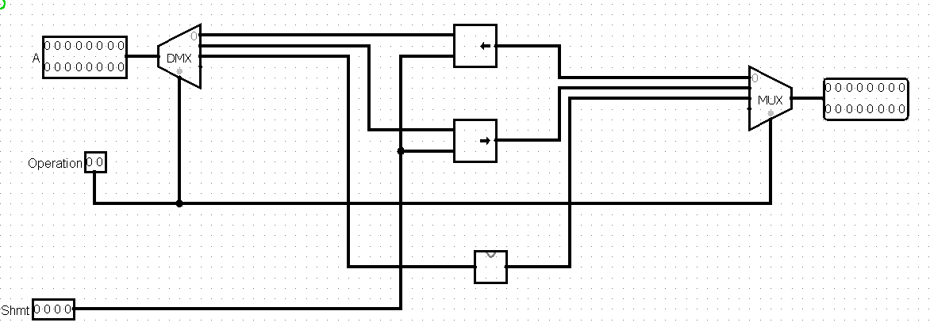
Single Operand Circuit

Slide 17
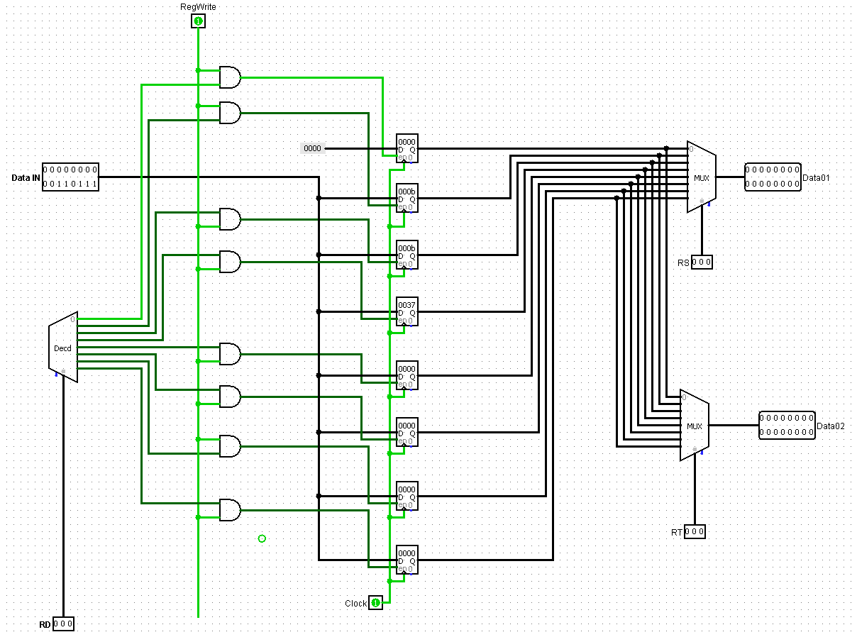
Register file:
Used to store the temporary data while programs are executed
Data used in ALU are taken from these registers. So data from memory have to be loaded to register file first
Each register stores 16 bits
Since our register indexes are of 3 bits, we can have a maximum of 8 registers

Slide 18
Program counter, Instruction Memory and Data Memory:
We used the built in “Counter” in Logisim as our program counter. But, it is configured to load the data from its input, NOT increment by 1 in each step.
We are loading 16 bits simultaneously in Logisim, so instructions are stored in consecutive addresses. So we have to add 1 to the current value of program counter in each no-branching step.
We used the built in “ROM” in Logisim as our instruction memory.
We used the built in “RAM” in Logisim as our data memory.
Both RAM and ROM store 16 bits in each address.

Slide 19
Limitations:
Few registers available (only 8). It is a tradeoff as keeping 3 bits for register index allowed us to have 3 bits for shift amount (hence perform shift operations) and 4 bits for opcode (16 unique operations)
No separate circuit for multiplication and division, have to be done using addition/ subtraction and for loop
No function bits available in R-format, which limits the number of operations available
Few operations compared to bigger processors (e.g: 32 bit or 64 bit)

Slide 20
Program to be executed:
Write a program that calculates sum of 10 natural numbers using for loop and execute the program using your designed processor.
Our approach:
We will add 1 to 10 (both inclusive) by incrementing by 1 in each step.

Slide 21
Program:
addi $1 $0 11 //n=1
addi $2 $0 1 // i=1
addi $3 $0 0 // sum=0
(Loop:) beq $2 $1 3 // if i==n, branch
add $3 $3 $2 // sum+=i
addi $2 $2 1 // i+=1
beq $0 $0 -4 // if 0==0, branch
la $4 $0 0 // load address to register
(End:) sw $3 0($4) // store sum to memory

Slide 22
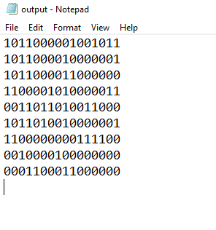
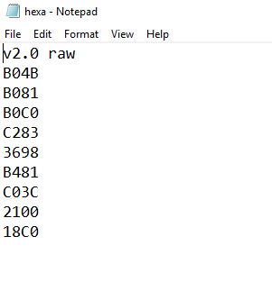
Compiler outputs:

Slide 23
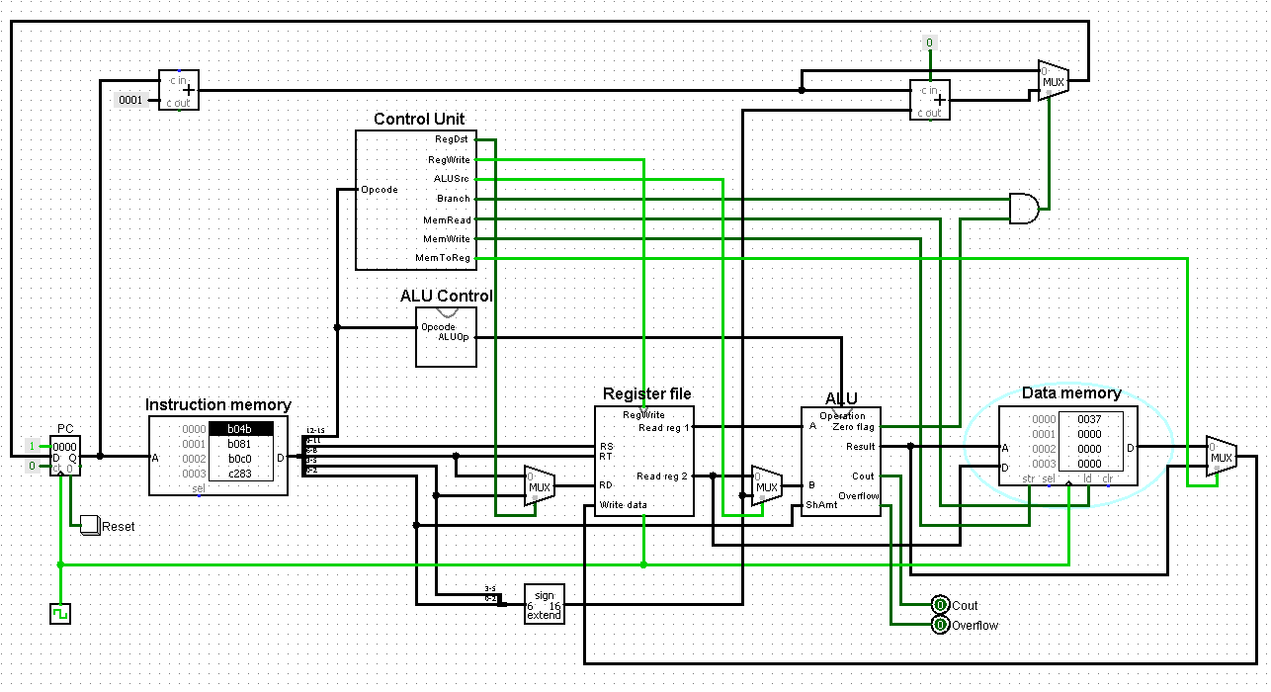
Datapath after executing the program:
Result

Slide 24
Thank you!

